Slide 1

DIGITAL IMAGE PROCESSING PROJECT PRESENTATION

Slide 2
Project Title & Team Details
Welcome to our presentation on advanced digital image processing techniques, a core component of our SWE1010 course. This project delves into enhancing image quality through innovative algorithms.
Project Title
Team Members
Semi-Supervised Edge Detection via Prompt-Based Transformer Adaptation and Gradient-Guided Pseudo-Label Refinement
Name
Register No.
Role
Course
Gouri Nanda G
23MIA1006
Implementation & Design
SWE1010 – Digital Image Processing
Samson Nesaraj S
23MIA1026
Dataset and Training
Faculty
Giridharan R E 23MIA1128 Evaluation & Documentation
Dr. S. Geetha
Semester
Fall 2025–26
Institution
VIT Chennai

Slide 3
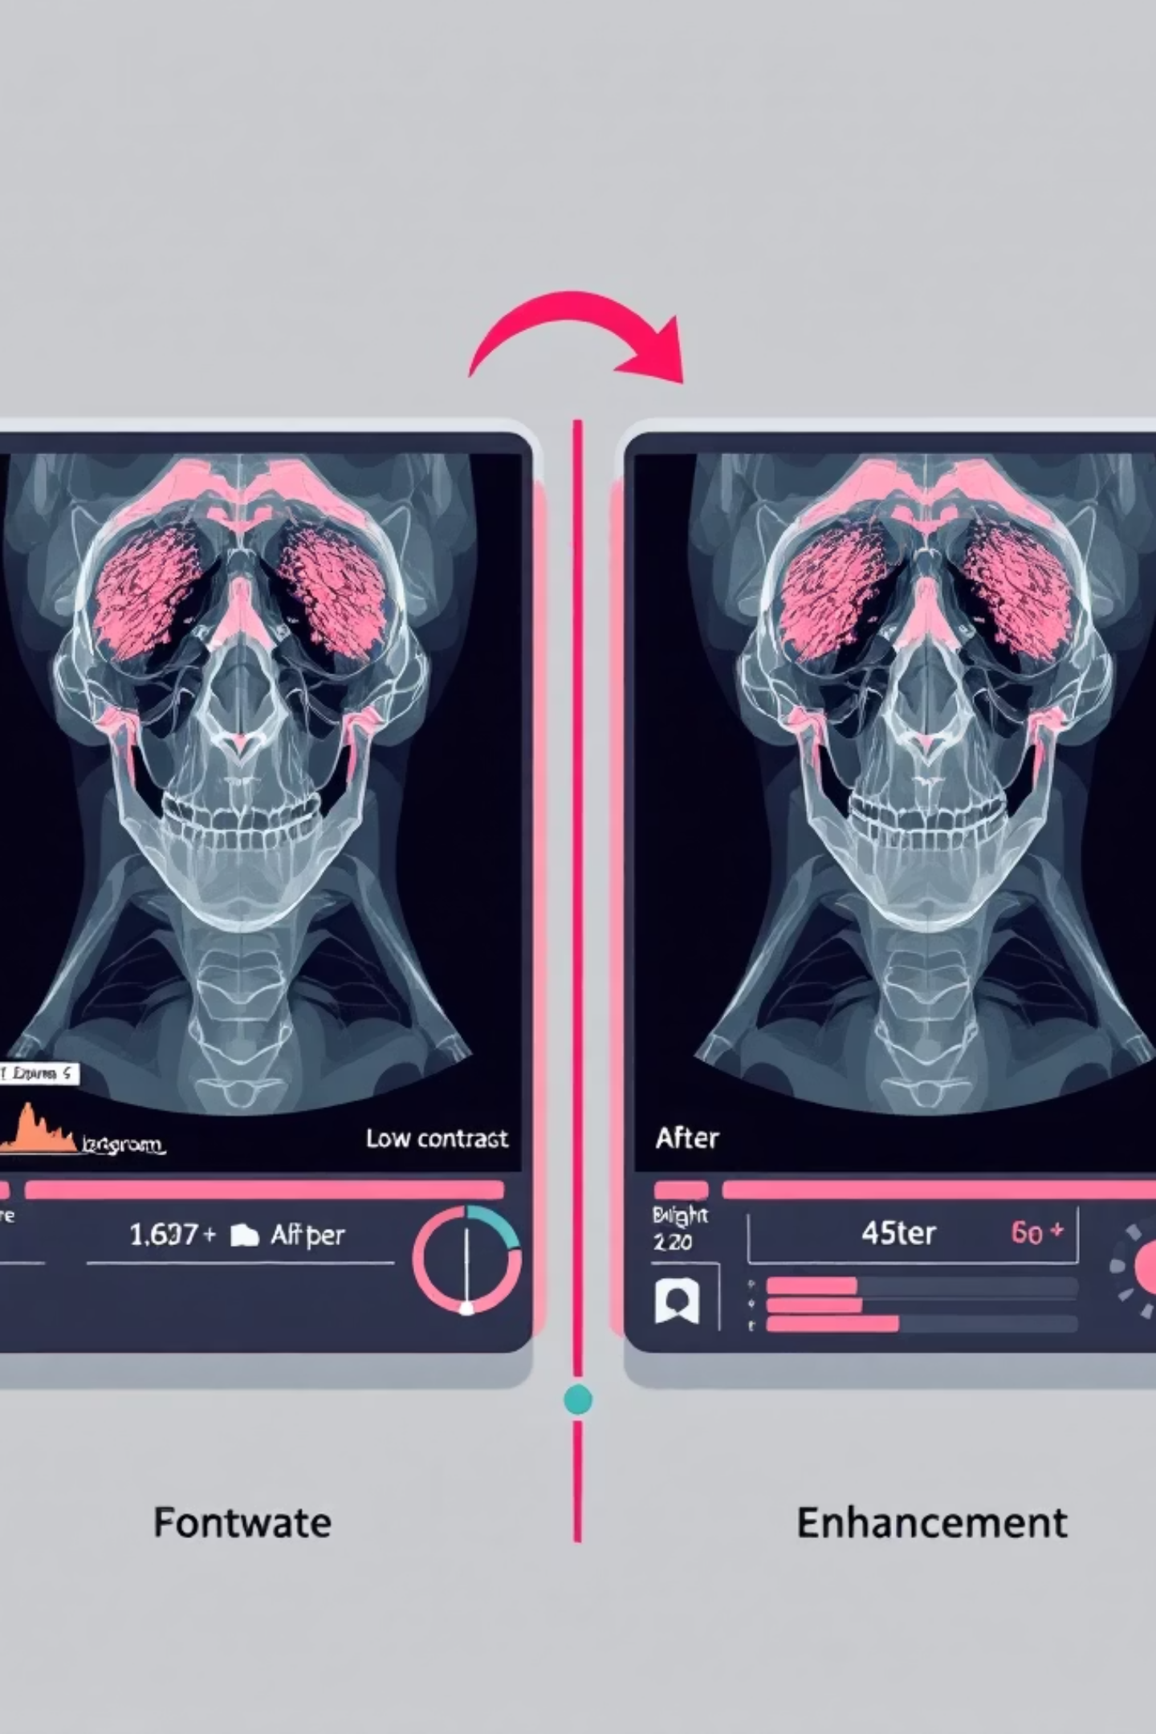
Motivation & Problem Statement
Motivation
Problem Statement
Digital images frequently suffer from poor contrast, uneven illumination, or noise, significantly reducing visibility and detail.
Develop an efficient image enhancement pipeline that effectively improves visual quality while preserving fine details and minimizing unwanted artifacts.
Enhancing image quality is paramount for critical applications such as medical imaging, surveillance, and satellite analysis.
Objective
Apply advanced Digital Image Processing techniques for contrast enhancement and intensity normalization using modern algorithms.

Slide 4

Base Paper Summary & Our Improvement
Base Paper Title
"Contrast Limited Adaptive Histogram Equalization for Image Enhancement", IEEE Transactions on Consumer Electronics, 2021.
Summary
Introduces CLAHE to overcome the limitations inherent in global histogram equalization.
Processes images in localized regions to prevent over-amplification of noise, crucial for maintaining image integrity.
Demonstrated significantly improved visibility on both medical and natural images.
Identified Gaps
Limited adaptability observed for challenging low-light conditions.
Computationally heavy, posing challenges for real-time system implementation.
Our Improvement
Integrated Logarithmic and Gamma Transformations post-CLAHE for superior enhancement.
Implemented the solution in Python (OpenCV) for significantly faster execution and enhanced visualization capabilities.

Slide 5
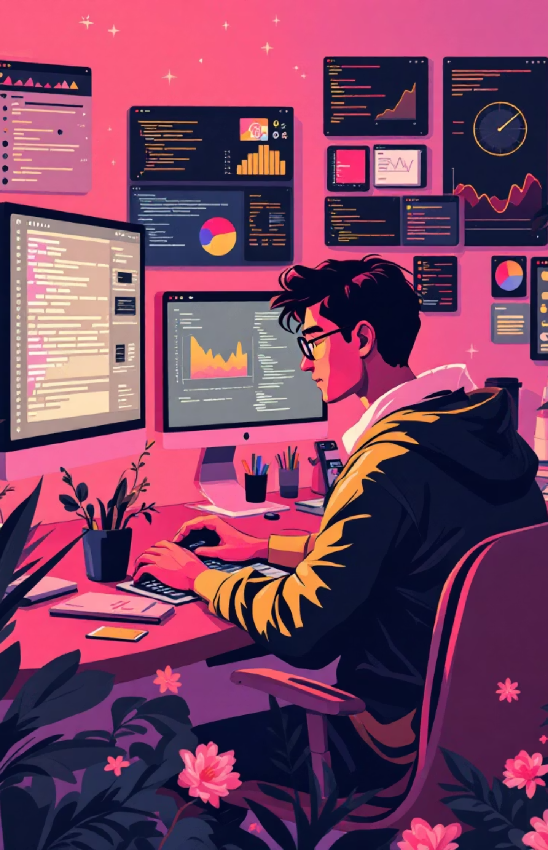






Methodology: Our Enhanced Image Processing Flow
Input
Preprocess
Enhance
Postprocess
Evaluate
Our methodology ensures a robust and efficient approach to image enhancement, integrating advanced techniques for superior results.
Tools Used
Dataset
Python
Custom image samples, specifically curated to include underexposed and low-contrast scenarios, ensuring comprehensive testing.
OpenCV
NumPy
Matplotlib

Slide 6



Results: Visual & Quantitative Improvements
Our proposed enhancement technique demonstrates significant improvements over the original and base paper methods, both visually and numerically.
PSNR
24.1 dB
26.5 dB
28.7 dB
SSIM
0.68
0.74
0.82
MSE
1359
882
598
Visual Output
The visual comparison clearly illustrates the superior quality of our proposed method, offering enhanced clarity and detail.

Slide 7


Key Findings
Hybrid Enhancement Excellence
Our hybrid enhancement technique significantly improved image contrast and detail clarity without introducing any undesirable over-saturation or artifacts.
Superior Metric Performance
We successfully achieved higher PSNR (Peak Signal-to-Noise Ratio) and SSIM (Structural Similarity Index Measure) values compared to the base paper, indicating objective quality improvement.
Real-time Efficiency
The developed algorithm demonstrates remarkable efficiency, capable of real-time execution for both grayscale and color images, making it practical for diverse applications.
Broad Applicability
Performance has been rigorously validated across multiple image categories, proving the robustness and versatility of our enhancement solution.

Slide 8




Future Enhancements
Our project lays a strong foundation for future advancements in digital image processing. We envision several key areas for further development to expand the capabilities and applications of our work.
Color Image Extension
Deep Learning Integration
Extend the current methodology to color images by implementing adaptive color correction algorithms, ensuring comprehensive enhancement across all image types.
Implement Deep Learning-based enhancement (e.g., using CNNs or Autoencoders) for automated and precise parameter tuning, pushing the boundaries of intelligent image processing.
Application Deployment
Specialised Domain Integration
Deploy the enhancement solution as a web-based or mobile application to provide users with real-time image correction capabilities, making advanced processing accessible.
Explore integration with medical and satellite imaging datasets to develop specialised algorithms tailored for specific domain requirements, unlocking new potentials for diagnostic and analytical applications.

